Slide 1
Introduction to Naïve Bayes
Word Embedding
“Word is characterized by the company it keeps”

Slide 2
Bayes’ Theorem
In probability theory and statistics, Bayes’ theorem (alternatively Bayes’ law or Bayes' rule) describes the probability of an event, based on prior knowledge of conditions that might be related to the event.
(source https://en.wikipedia.org/wiki/Bayes%27_theorem)

Slide 3
Prior vs Posterior Probabilities
What is the probability that India will win the match against Australia?
Prior Probabilities
P(Win) = 50 %
P(Not win) = 50%
What is the probability that India will win the match against Australia?
Posterior Probabilities
Given that we have lost five wickets and we need 200 more runs to win?
P(Win) = 20 %
P(Not win) = 80%

Slide 4
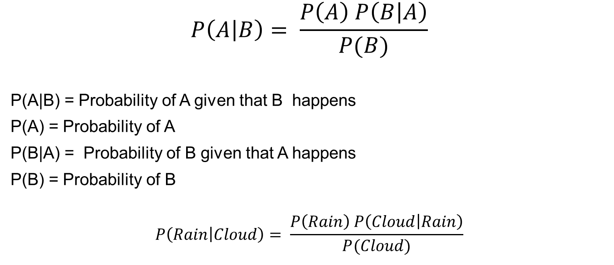
Bayes’ Theorem
$$P\left(A | B\right)= \frac{P\left(A\right) P\left(B | A\right)}{P(B)}$$
P(A|B) = Probability of A given that B happens
P(A) = Probability of A
P(B|A) = Probability of B given that A happens
P(B) = Probability of B
$$P\left(Rain | Cloud\right)= \frac{P\left(Rain\right) P\left(Cloud | Rain\right)}{P(Cloud)}$$

Slide 5
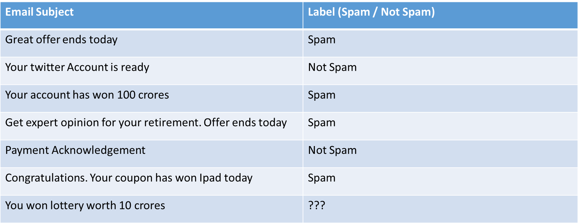
Spam Filtering

Slide 6
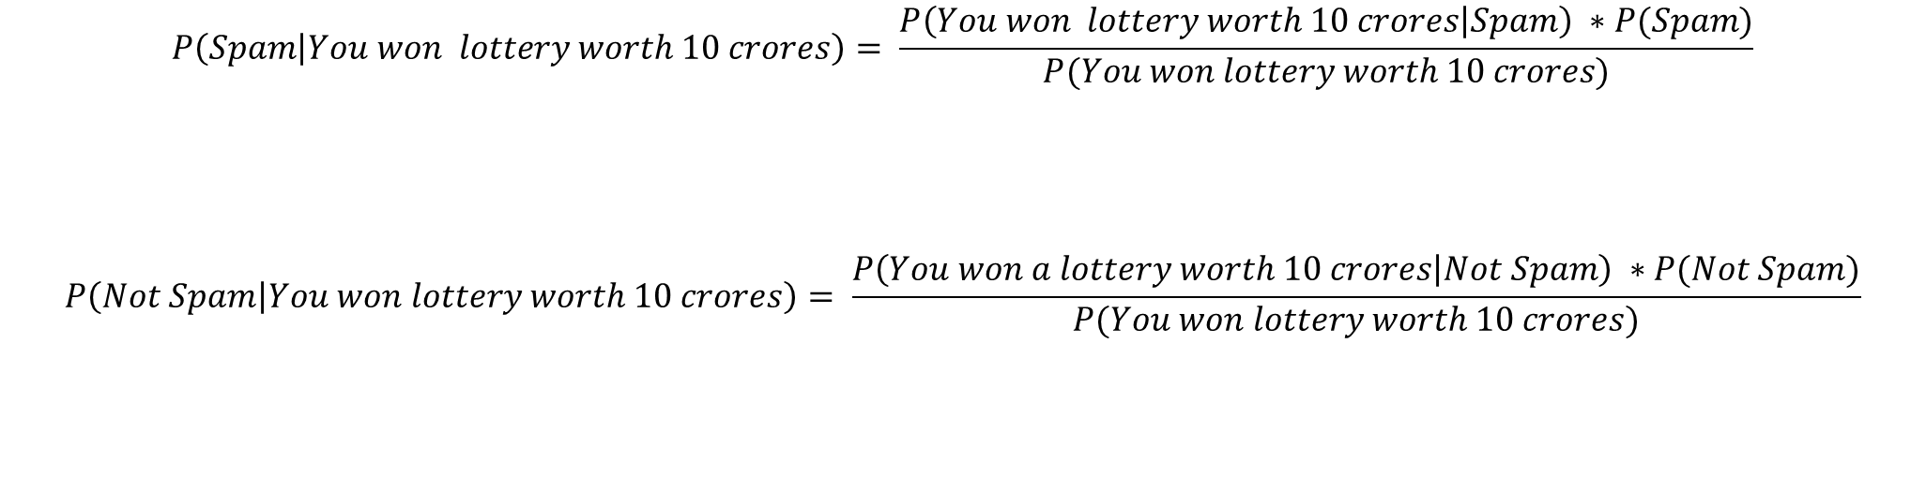
Bayes’ Theorem
$$P\left(Spam | You won lottery worth 10 crores\right)= \frac{P\left(You won lottery worth 10 crores | Spam\right) ∗P(Spam)}{P(You won lottery worth 10 crores)}$$
$$P\left(Not Spam | You won lottery worth 10 crores\right)= \frac{P\left(You won a lottery worth 10 crores | Not Spam\right) ∗P(Not Spam)}{P(You won lottery worth 10 crores)}$$

Slide 7
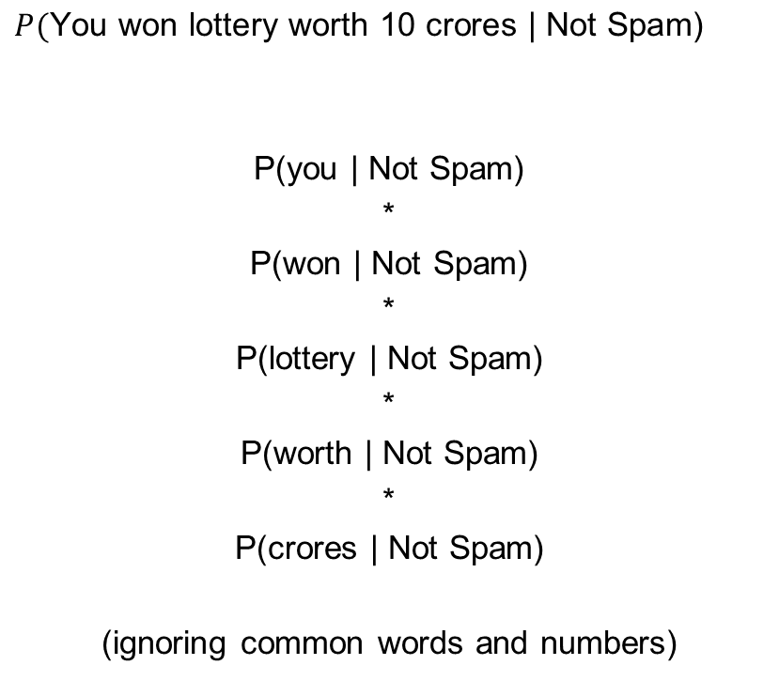
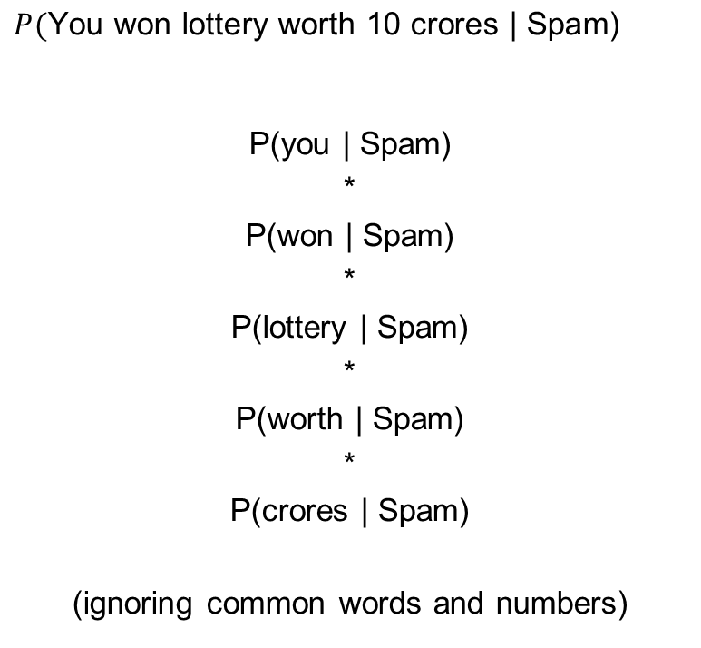
Being Naive
$$P(\text{You} \text{won} \text{lottery} \text{worth}\text{ 10 }\text{crores}\text{ | }\text{Spam}\text{)}$$
P(you | Spam)
*
P(won | Spam)
*
P(lottery | Spam)
*
P(worth | Spam)
*
P(crores | Spam)
(ignoring common words and numbers)
$$P(\text{You} \text{won} \text{lottery} \text{worth}\text{ 10 }\text{crores}\text{ | }\text{Not} \text{Spam}\text{)}$$
P(you | Not Spam)
*
P(won | Not Spam)
*
P(lottery | Not Spam)
*
P(worth | Not Spam)
*
P(crores | Not Spam)
(ignoring common words and numbers)

Slide 8
Count of words
Number of unique words under spam category: 15 words (ignoring has, 100, for, is)
(great, offer, ends, today, your, account, won, crores, get, expert, opinion, retirement, congratulations, coupon, ipad)
Number of unique words under Not Spam category: 6 words (ignoring is)
(your, twitter, account, ready, payment acknowledge)
Total number of unique words: 19 words (ignoring has, 100, for, is)
(great, offer, ends, today, your, account, won, crores, get, expert, opinion, retirement, congratulations, coupon, ipad, twitter, ready, payment, acknowledgement)

Slide 9
Being Naive
P(you | Spam) = (0 + 1) / (15 + 19) = 0.029
P(won | Spam) = (2 + 1) / (15 + 19) = 0.088
P(lottery | Spam) = (0 + 1) / (15 + 19) = 0.029
P(worth | Spam) = (0 + 1) / (15 + 19) = 0.029
P(crores | Spam) = (1+1)/(15 + 19) = 0.058
P(you won lottery worth crores | Spam) =
(0.029 * 0.088 * 0.029 * 0.058) = 0.00000429
P(you | Not Spam) = (0 + 1) / (6 + 19) = 0.04
P(won | Not Spam) = (0 + 1) / (6 + 19) = 0.04
P(lottery | Not Spam) = (0 + 1) / (6 + 19) = 0.04
P(worth | Not Spam) = (0 + 1) / (6 + 19) = 0.04
P(crores | Not Spam) = (0 + 1)/(6 + 19) = 0.04
P(you won lottery worth crores | Not Spam) =
(0.04 * 0.04 * 0.04 * 0.04 * 0.04) = 0.00000256

Slide 10
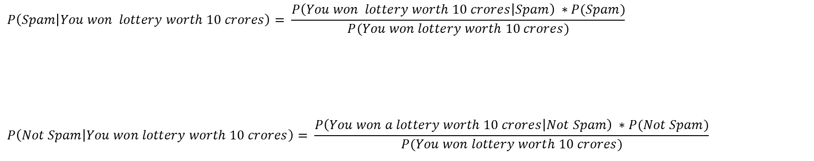
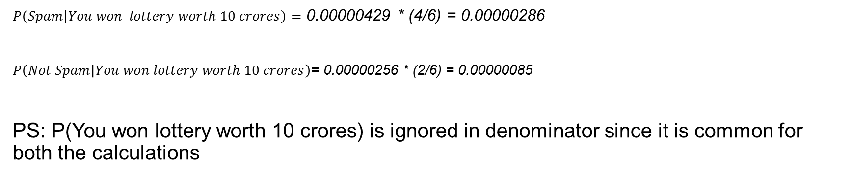
Bayes’ Theorem
$$P\left(Spam | You won lottery worth 10 crores\right)= \frac{P\left(You won lottery worth 10 crores | Spam\right) ∗P(Spam)}{P(You won lottery worth 10 crores)}$$
$$P\left(Not Spam | You won lottery worth 10 crores\right)= \frac{P\left(You won a lottery worth 10 crores | Not Spam\right) ∗P(Not Spam)}{P(You won lottery worth 10 crores)}$$
$P\left(Spam | You won lottery worth 10 crores\right)=$ 0.00000429 * (4/6) = 0.00000286
$P\left(Not Spam | You won lottery worth 10 crores\right)$= 0.00000256 * (2/6) = 0.00000085
PS: P(You won lottery worth 10 crores) is ignored in denominator since it is common for both the calculations

Slide 11
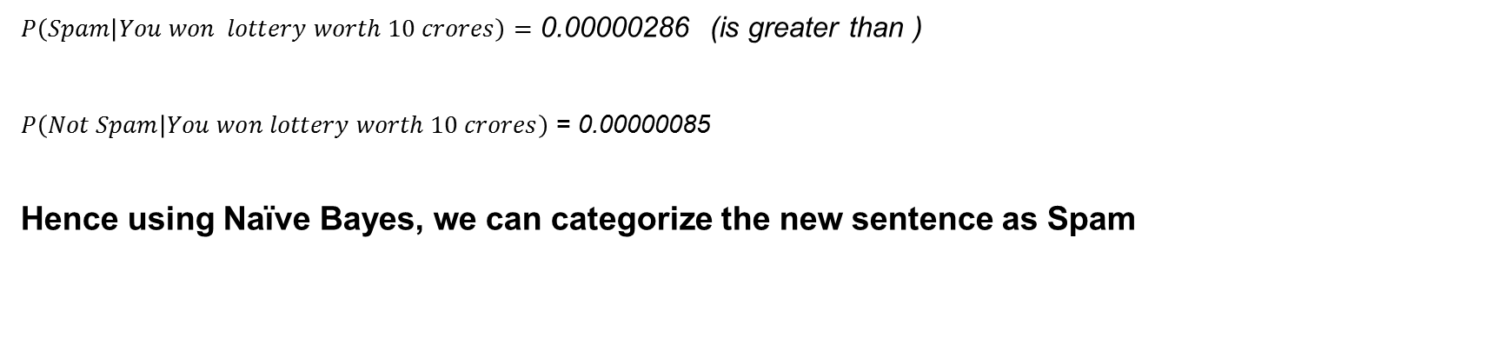
Bayes’ Theorem
$P\left(Spam | You won lottery worth 10 crores\right)=$ 0.00000286 (is greater than )
$P\left(Not Spam | You won lottery worth 10 crores\right)$ = 0.00000085
Hence using Naïve Bayes, we can categorize the new sentence as Spam

